Slide 1

THE ISLAMIC PRINCIPLES PERTAINING TO LAWFUL (HELAL) AND PROHIBITED (HARAM)

Slide 2
Outline
General principles pertaining lawful and prohibited
Food and Drink
Clothing and Adornment
Work and Earning Livelihood
Opposite gender
Business Transactions

Slide 3
Halal
Any action which is approved by the Quran or the express approval or silence from the Prophet.
English meaning: lawful

Slide 4
Haram
Any action forbidden by Allah in the Quran or by the Prophet. Any action against the spirit of Islam.
English meaning: unlawful

Slide 5
Makruh
Makruh (Arabic: مكروه) refers to an action that is disliked or detestable in nature. Although it isn’t in the same category as something that is Haram i.e. sinful, avoiding such an action is encouraged and rewarded..

Slide 6
The principles pertaining to lawful and prohibited
Nothing is forbidden except what is explicitly prohibited by God and His messenger.( every thing is lawful)
To make lawful and to prohibit is the right of God alone.
Prohibiting the lawful and permitting the prohibited is similar to committing shirk.
The prohibition of things is due to their impurity and harmfulness.
Whatever is conducive to forbidden is itself forbidden.
Actions will be judged by intentions.

Slide 7
7.What is permitted is sufficient, while what is prohibited is superfluous.
8.The Haram is prohibited to everyone alike.
9. Necessity dictates exception.
10 Doubtful things are to be avoided

Slide 8
Quranic teachings
حُرِّمَتْ عَلَيْكُمُ الْمَيْتَةُ
وَالدَّمُ
وَلَحْمُ الْخِنزِيرِ
وَمَا أُهِلَّ لِغَيْرِ اللَّهِ بِهِ
وَالْمُنْخَنِقَةُ
وَالْمَوْقُوذَةُ
وَالْمُتَرَدِّيَةُ
وَالنَّطِيحَةُ
وَمَا أَكَلَ السَّبُعُ
إِلَّا مَا ذَكَّيْتُمْ وَمَا ذُبِحَ عَلَى النُّصُبِ وَأَن تَسْتَقْسِمُوا بِالْأَزْلَامِ ۚ ذَٰلِكُمْ فِسْقٌ

Slide 9
Forbidden unto you (for food) are:
carrion
blood
swine flesh,
that which hath been dedicated unto any other than Allah,
strangled,
dead through beating,
dead through falling from a height,
by (the goring of) horns,
devoured of wild beasts, saving that which ye make lawful (by the death-stroke),
and that which hath been slaughtered unto idols. And (forbidden is it) that ye swear by the divining arrows. This is an abomination.
.

Slide 10
وَلَا تَأْكُلُوا مِمَّا لَمْ يُذْكَرِ اسْمُ اللَّهِ عَلَيْهِ وَإِنَّهُ لَفِسْقٌ
And eat not of that whereon Allah's name hath not been mentioned, for lo! it is abomination. (6 Surat-ul-Anaam . Aayat121)
وَأُحِلَّتْ لَكُمُ ٱلْأَنْعَٰمُ إِلَّا مَا يُتْلَىٰ عَلَيْكُمْۖ فَٱجْتَنِبُوا۟ ٱلرِّجْسَ مِنَ ٱلْأَوْثَٰنِ وَٱجْتَنِبُوا۟ قَوْلَ ٱلزُّورِ
The cattle are lawful unto you save that which hath been told you. So shun the filth of idols, and shun lying speech,(22 Surat-ul-Hajj . Aayat30)
Those who swallow usury cannot rise up save as he ariseth whom the devil hath prostrated by (his) touch. That is because they say: Trade is just like usury; whereas Allah permitteth trading and forbiddeth usury

Slide 11
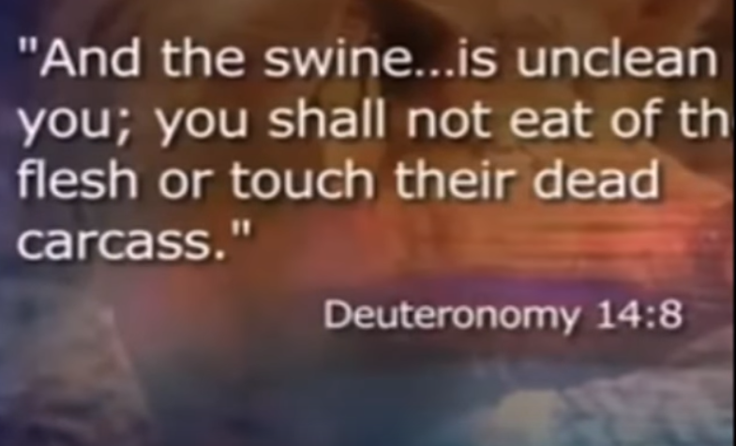
Pig Is unlawful even in Christianity

Slide 12
PROHIBITED
Omens by drawing lots
Usury
Adultery
Alcohol
Pork
Backbiting, slander

Slide 13
PERMITTED
Istikhara
Profitable trade
Marriage
Every nontoxic drink
Goat, sheep, cow, chicken
Good conversation

Slide 14
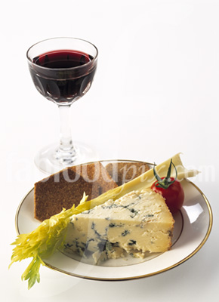
Food and Drink

Slide 15
Meat
يَٰٓأَيُّهَا ٱلنَّاسُ كُلُوا۟ مِمَّا فِى ٱلْأَرْضِ حَلَٰلًا طَيِّبًا “O mankind! Eat of what is permissible and good on earth,.” (2:168)
What is prohibited?
1. Eating What Is Dead
repugnant to civilized taste, contrary to human dignity
acute or chronic disease, through eating a poisonous plant, or other similar causes

Slide 16
2. Flowing Blood
It is not prohibited to consume the blood which remains in the flesh of the slaughtered animal
Repugnant to human decency and it may be injurious to health.
3. Pork
Not healthy and clean food
It is also prohibited in Judaism
It should be noted that this animal does not offend Muslims

Slide 17
4. That which is dedicated to anyone other than God
Pronouncing the name of Allah while slaughtering the animal is a declaration that one is taking the life of this creature by the permission of its Creator
The Conditions of Islamic Slaughtering
The animal should be slaughtered: No name other than Allah's should be mentioned over the animal
The name of Allah should be mentioned while slaughtering the animal (polytheists, unbelievers)

Slide 18
Haram Animals are:
The consumption of the following animals is against the dietary laws of Islam. Likewise, any ingredient or product derived from them or is contaminated with them, also is prohibited for a Muslim to consume, as described by the list below:
Meat of swine (pig) including all it’s by products.
Meat of an animal that was not blessed with the name of Allah (SWT) at the time of slaughter.
Animals killed in a manner, which prevents their blood being fully drained from their bodies.
Meat of dead animals

Slide 19
.
Carnivorous animals with fangs, example: lions, dogs, wolves, tigers, etc…
Birds of prey, example: falcons, eagles, owls, vultures, etc…
Reptiles, snakes, crocodiles.
Pest’s example: rats and scorpions.
Insects excluding locusts.

Slide 20
Unlawful Organs of Animals Slaughtered as Halal
Flowing Blood
Male reproductive organ
reproductive organs
Testicles
Pancreas
Gall bladder
Bladder

Slide 21
4. Slaughter by Jews and Christians
ٱلْيَوْمَ أُحِلَّ لَكُمُ ٱلطَّيِّبَٰتُۖ وَطَعَامُ ٱلَّذِينَ أُوتُوا۟ ٱلْكِتَٰبَ حِلٌّ لَّكُمْ وَطَعَامُكُمْ حِلٌّ لَّهُمْۖ “
Today whatever is good is made lawful to you. And the food of those who were given the Scripture (before you) is permitted to you and your food is permitted to them...” (5:6 (5)

Slide 22
INTOXICANTS AND DRUGS
Any alcoholic drink which causes intoxication is forbidden.
Mental disorders, delirium tremens, nervous breakdowns, ailments of the digestive tract, suicides, homicides, bankruptcies, sales of properties etc.
Any substance or drug which has the effect of befogging or clouding the mind is prohibited
RULE:
Whatever intoxicates is prohibited in any amount

Slide 23
TRADING IN ALCOHOL
Hadith
“Truly, Allah has cursed wine (intoxicants) and has cursed the one :-
1 who produces it,
2 the one for whom it is produced,
3 the one who drinks it,
3 the one who serves it,
4 the one who carries it,
5 the one for whom it is carried,
6 the one who sells it,
7 the one who earns from the sale of it,
8 the one who buys it,
9 and the one for whom it is bought.”

Slide 24
Contt:
Alcohol Cannot Be Given as a Gift
“…'Shall I not sell it?' asked the man.
'The One Who Prohibited drinking it has also prohibited selling it,' replied the Prophet (pbuh).
'Shall I not give it to a Jew as a gift?' asked the man.
'The One Who has prohibited it has also prohibited that it be given as a gift to the Jew,' said the Prophet.
'Then what shall I do with it?' asked the man.
'Pour it on the ground,' the Prophet replied.
(Reported by al-Hameedi in his Musnad. )

Slide 25
Clothing and Adornment

Slide 26
Cleanliness and Beautification
"Cleanse yourself, for Islam is cleanliness." (Reported by Ibn Hayyan.)
"Does he have nothing with which to comb his hair?" (Reported by Abu Daoud.)
Gold and Pure Silk are prohibited for Men while permitted for women
Islam safeguards the manly qualities of men
the love of jewelry and ornaments is quite natural and becoming for a woman

Slide 27
The Dress of the Muslim man
Covering from belly button to knees
"Be different from the polytheists: let the beard grow and trim the moustache." hadith
The Dress of the Muslim Woman
Covering from head to toe
clothes which fail to cover the body
which are transparent, revealing what is underneath.
tightly fitting clothes which delineate the parts of the body

Slide 28
Concerning woman's imitating man and vice versa
“The Prophet (pbuh) declared that a woman should not wear a man's clothing nor a man of a woman's. He cursed men who imitate women and women who imitate men.” (Hadith)
Aspects of such imitation include the manner of speaking, walking, dressing, moving and so on.
The prohibition of tattooing, cutting the teeth, and undergoing surgery for beautification

Slide 29
WORK AND BUSINESS TRANSACTIONS

Slide 30
Ahadith about work
The obligation to work if one is able
"Charity is lawful neither for the rich nor for the able bodied." (Hadith)
It is better that a person should take a rope and bring a bundle of wood on his back to sell so that Allah may preserve his honor, than that he should beg from people, (regardless of) whether they give to him or refuse him. (Hadith)
Beneficial works for God’s creatures
When a Muslim plants a plant or cultivates a crop, no bird or human being eats from it without its being accounted as a (rewardable) charity for him. (Hadith)

Slide 31
Work
Industries and professions condemned by islam
Prostitution, Erotic Arts, Manufacturing Intoxicants and Drugs, Interest / usury
'Allah will punish anyone who makes figures until he breathes spirit into them, which he can never do.‘ (Hadith)
Responsibilities in regard to work
“Woe to the rulers, the leaders, and the trustees! On the Day of Resurrection some people will wish that they could be suspended between heaven and earth rather than having had the burden of their responsibilities.” Hadith

Slide 32
BUSINESS TRANSACTIONS
The Prohibition of Selling Forbidden Goods
The Prohibition of a Sale Involving Uncertainty
Price Manipulation

Slide 33
Business Transactions
The Condemnation of Hoarding
"If anyone withholds grain for forty days out of the desire for a high price, Allah will renounce him." (Reported by Ahmad, al-Hakim, Ibn Abu Shaybah, and al-Bazzar.)
The Permissibility of Brokerage
Exploitation and Fraud
"He Who Deceives Us Is Not of Us" hadith
Frequent Swearing
"Swearing produces a ready sale but blots out the blessing." (Reported by al-Bukhari.)

Slide 34
Business Transactions
The Prohibition of Usury/ Interest
يَٰٓأَيُّهَا ٱلَّذِينَ ءَامَنُوا۟ ٱتَّقُوا۟ ٱللَّهَ وَذَرُوا۟ مَا بَقِىَ مِنَ ٱلرِّبَوٰٓا۟ إِن كُنتُم مُّؤْمِنِينَ
“O you who believe, fear Allah and give up what remains due to you of interest if you are indeed Believers. And if you do not, then be warned of war (against you) by Allah and His Messenger, while if you repent you shall have your capital. Do not do wrong and you shall not be wronged.” (The Qur’an 2:278-279)
The taking of interest implies appropriating another person's property without giving him anything in exchange
Dependence on interest prevents people from working to earn money,

Slide 35
The Physical Appetites
Adultery
وَلَا تَقْرَبُوا۟ ٱلزِّنَىٰٓۖ إِنَّهُۥ كَانَ فَٰحِشَةً وَسَآءَ سَبِيلًا
“..do not come near adultery; indeed, it is an abomination and an evil way (17:32),
Privacy
Islam prohibits Privacy denoting a man and woman's being alone together in a place in which there is no fear of intrusion by anyone else
Looking With Desire at the Opposite gender
“Tell the believing men that they should lower their gazes and guard their sexual organs; that is purer for them. Indeed, Allah is well-acquainted with what they do. And tell the believing women that they should lower their gazes and guard their sexual organs, and not display their adornment, except that which is apparent of it…”

Slide 36
Man to man, woman to woman
“A man should not look at the private organs of another man, nor a woman of a woman, nor should a man go under one cloth with another man, nor a woman with another woman..” (Hadith)
Homosexuality
أَتَأْتُونَ ٱلذُّكْرَانَ مِنَ ٱلْعَٰلَمِينَ
“What! Of all creatures, do you approach males and leave the spouses whom your Lord has created for you? Indeed, you are people transgressing (all limits)!” (26: 165-166)

Slide 37
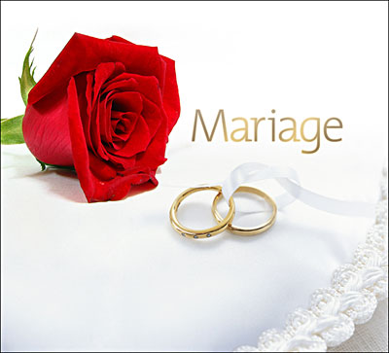
Marriage

Slide 38
No Monasticism
“People before you perished because of their asceticism; they made excessive demands on themselves until Allah brought hardships on them: you can still see a few of them remaining in monasteries and temples..." (Hadith)
Prohibited Proposals
“A man must not propose to another man's betrothed unless he withdraws or gives him permission.” (Hadith)

Slide 39
Women To Whom Marriage is Prohibited
حُرِّمَتْ عَلَيْكُمْ :
أُمَّهَٰتُكُمْ
وَبَنَاتُكُمْ
وَأَخَوَٰتُكُمْ
وَعَمَّٰتُكُمْ
وَخَٰلَٰتُكُمْ
وَبَنَاتُ ٱلْأَخِ
وَبَنَاتُ ٱلْأُخْتِ
وَأُمَّهَٰتُكُمُ ٱلَّٰتِىٓ أَرْضَعْنَكُمْ
وَأَخَوَٰتُكُم مِّنَ ٱلرَّضَٰعَةِ

Slide 40
وَأُمَّهَٰتُ نِسَآئِكُمْ
وَرَبَٰٓئِبُكُمُ ٱلَّٰتِى فِى حُجُورِكُم مِّن نِّسَآئِكُمُ ٱلَّٰتِى دَخَلْتُم بِهِنَّ فَإِن لَّمْ تَكُونُوا۟ دَخَلْتُم بِهِنَّ فَلَا جُنَاحَ عَلَيْكُمْ
وَحَلَٰٓئِلُ أَبْنَآئِكُمُ ٱلَّذِينَ مِنْ أَصْلَٰبِكُمْ
وَأَن تَجْمَعُوا۟ بَيْنَ ٱلْأُخْتَيْنِ إِلَّا مَا قَدْ سَلَفَۗ

Slide 41
1 The father's wife, whether divorced or widowed.
2 The mother, including the grandmothers on both sides.
3 The daughter, including the granddaughters from the son or daughter.
4 The sister, including the half, and step-sisters.
5 The paternal aunt, whether she is the real, half, or step-sister of the father.
7 The maternal aunt, whether she is the real, half, or step-sister of the father.
8 The brother's daughter, i.e., his niece.
The sister's daughter, i.e., his niece.
your [milk] mothers who nursed you,
your sisters through nursing
your wives' mothers
your step-daughters
your guardianship [born] of your wives
wives of your sons
and that you take [in marriage] two sisters simultaneously

Slide 42
Women To Whom Marriage is allowed
Marriage to the Women of the People of the Book is lawful
Polygamy
فَٱنكِحُوا۟ مَا طَابَ لَكُم مِّنَ ٱلنِّسَآءِ مَثْنَىٰ وَثُلَٰثَ وَرُبَٰعَۖ فَإِنْ خِفْتُمْ أَلَّا تَعْدِلُوا۟ فَوَٰحِدَةً
“If ye fear that ye shall not be able to deal justly with the orphans, Marry women of your choice, Two or three or four; but if ye fear that ye shall not be able to deal justly (with them), then only one…” (4/3)
“And you will not be able to do justice among (your) wives, however much you may wish to. But do not turn away (from one of them) altogether...”(4:139)

